Slide 1

MCU
49th Annual Membership Meeting

Slide 2


Agenda
Minutes of Preceding Annual Meeting
President’s Report
Financial Reports
Supervisory Committee Report
Loan Officer’s Report
Nominating Committee Recommendations and Vote

Slide 3
2024
Annual Meeting
Minutes

Slide 5

President’s Report

Slide 6

This report outlines the financial health of our Credit Union and reflects the continued support of the members who choose us as their trusted financial partner.
Founded in 1975 by employees of St. John’s Hospital in Springfield, Missouri, the Credit Union provides financial services across multiple states to Mercy Health employees, their affiliates, and their families. We are transitioning to a new brand identity that encompasses our entire membership, we have chosen the tree as our symbol—representing our deep roots, steady growth, longevity, and strength.
I would like to extend my sincere appreciation to the MCU management team and staff. Thank you for your hard work and unwavering dedication to our members; your collaboration and commitment have resulted in another successful year. Finally, I want to thank our members for entrusting us with your financial needs. We look forward to 2026 and the new opportunities to enhance your experience.
Tammy Rowden
President

Slide 7

Financial Reports

Slide 11

Supervisory Committee Report
Supervisory Committee Report
Supervisory Committee Report

Slide 12
Supervisory Report
The exam was conducted by the accounting firm KPM. The exam was conducted through December 31, 2024.
The annual audit performed by KPM is a Supervisory Exam on selected records, accounts and transactions of the credit union, in accordance of NCUA regulations.
The Annual Audit Report was reviewed by the Supervisory Committee and provided to the Board of Directors for applicable corrections or procedural changes.
The Supervisory Committee meets regularly to audit accounts and procedures.
Calahan Macy and Teresa Ukena – Supervisory Committee Members

Slide 13

Loan Officer’s Report by Priscilla Simon, VP Lending
Loan Officer’s Report

Slide 14
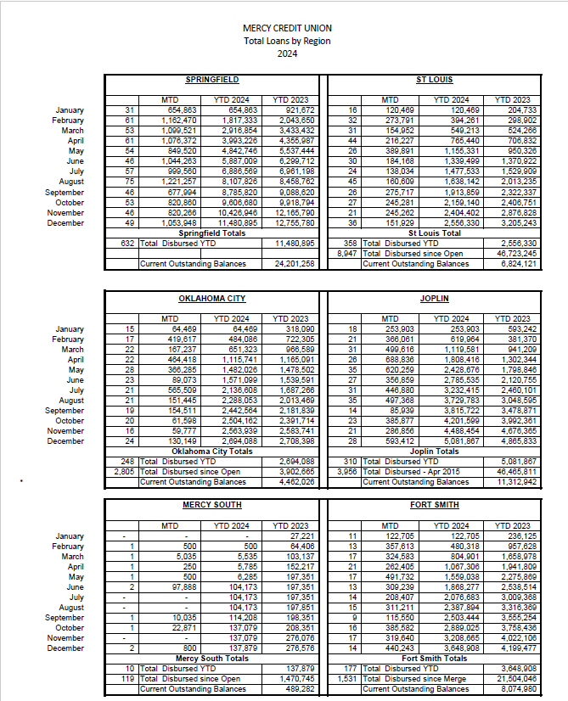

Slide 15
Loan Officer’s Report by Priscilla Simon, VP Lending
Nominating Committee Report

Slide 16
NOMINATING COMMITTEE REPORT
The following criteria are used for choosing nominees to serve:
Nominees need to be able to devote the time required to perform the position for which they are nominated.
The candidate should be capable of communicating effectively with officers and members.
The candidate will need to be impartial setting aside personal opinions and putting the Credit Union’s interest first.
The candidate must demonstrate knowledge or willingness to learn the Credit Union’s operation and financial aspects.
BOARD OF DIRECTORS – Seven Members PRESENT MEMBERS WITH RE-ELECTION YEAR:
Chris Bos 2027
Doug Fast 2027
Cindy Bennett 2027
Jodie Rayborn 2027
Dane Douglas 2027
Jimmie Howard 2027
Open Position
TO BE ELECTED:
Calahan Macy
SUPERVISORY COMMITTEE – Three Members
PRESENT MEMBERS
Teres Ukena
Todd Holbert
TO BE ELECTED:
Accepting Volunteer Applications
Nominating Committee
Cindy Bennett
Chris Bos
39 |

